Slide 1
Snowflake – Date & Time
Date
Snowflake supports a single DATE data type for storing dates – No Time
Format YYYY-MM-DD OR DD-MON-YYYY
Time
Snowflake supports a single TIME data type for storing times – HH:MI:SS
Fraction Seconds – Precision can range from 0 sec to 9 nano seconds
23:59:59.999999999 -- 9 is the default precision
TimeStamp
TIMESTAMP in Snowflake is a user-specified alias associated with one of the TIMESTAMP_* variations
TIMESTAMP_NTZ is the datatype for timestamps without a timezone (ntz = no time zone). This is also referred to as “walltime” as it is the time you would get by looking at a random clock on the wall and writing it down.
TIMESTAMP_TZ is the datatype for timestamps with timezones (tz = time zone). Annoyingly, Snowflake does not store the timezone associated with this timestamp. Instead, it stores the UTC offset associated with the timezone associated with this timestamp. This may sound pedantic, but it has consequences we’ll explore later.
TIMESTAMP_LTZ is the datatype for timestamps with timezones in the current session timezone used by Snowflake (ltz = local time zone). This is a nice idea because theoretically, every consumer would automatically work with timestamps in their local timezone

Slide 2
Snowflake – Date & Time
TimeStamp
TIMESTAMP_LTZ
TIMESTAMP_LTZ internally stores UTC time with a specified precision
All operations performed by local time zone
Controlled By TimeZone Session Parameter
Alias – TIMESTAMPLTZ
TIMESTAMP_NTZ
TIMESTAMP_NTZ internally stores “wallclock” time with a specified precision
No Timezone Considerations
Alias – TIMESTAMPNTZ, DATETIME
TIMESTAMP_TZ
TIMESTAMP_TZ internally stores UTC time together with an associated time zone offset
All operations are performed with the time zone offset specific to each record.
TIMESTAMP_TZ currently only stores the offset of a given time zone, not the actual time zone, at the moment of creation for a given value
Alias – TIMESTAMPTZ

Slide 3
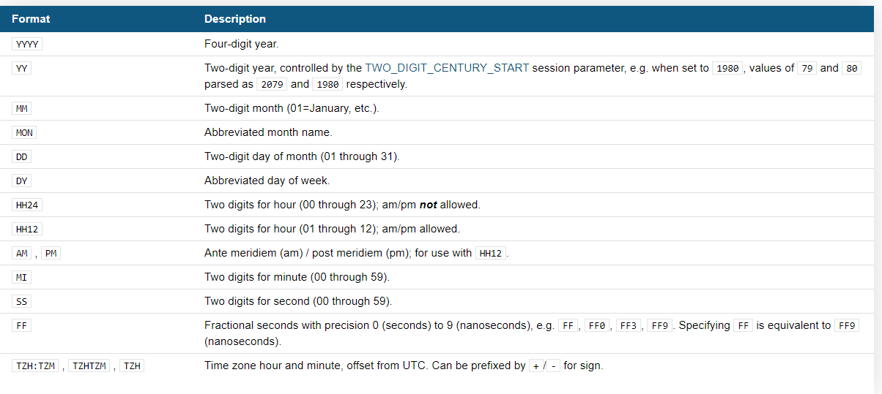
Snowflake – Date & Time
Date And Time Formats
When a date-only format is used, the associated time is assumed to be midnight of day.

Slide 4
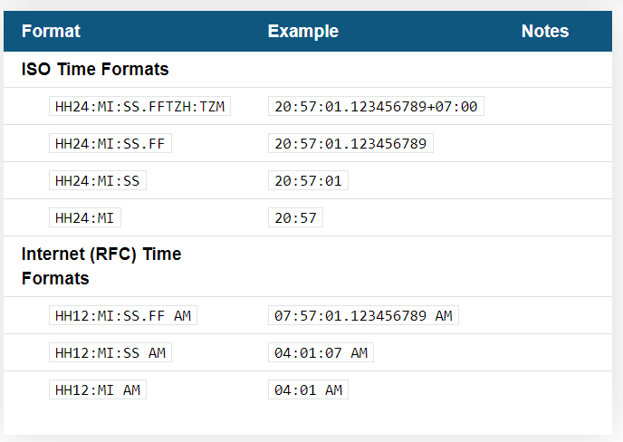
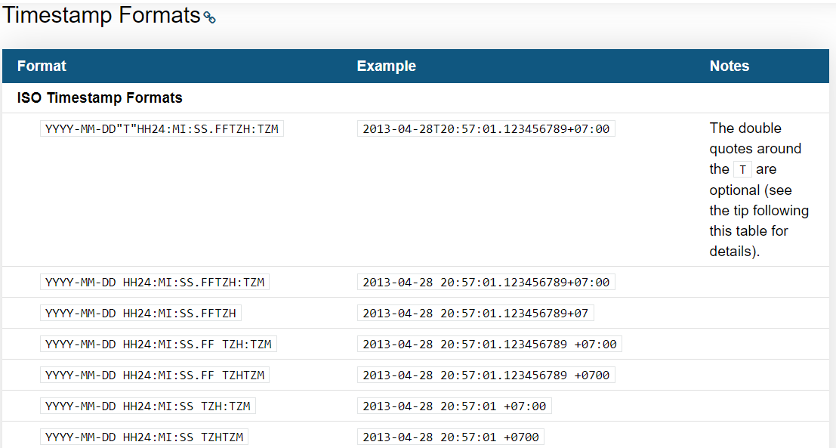
Snowflake – Date & Time
Time Formats

Slide 5
Snowflake – Date & Time
Calendar
Snowflake uses the Gregorian Calendar for all dates and timestamps
The Gregorian Calendar starts in the year 1582, but recognizes prior years, which is important to note because Snowflake does not adjust dates prior to 1582 (or calculations involving dates prior to 1582) to match the Julian Calendar.
Date and Time Constants
Constants (also known as literals) refers to fixed data values
Snowflake supports using single quotes to delimit string constants
Interval Constants
You can use interval constants to add or subtract a period of time to/from a date, time, or timestamp
Interval constants are implemented using the INTERVAL keyword, which has the following syntax:
{ + | - } INTERVAL '<integer> [ <date_time_part> ] [ , <integer> [ <date_time_part> ] ... ]’
INTERVAL '1 YEAR' represents 1 year.
INTERVAL '4 years, 5 months, 3 hours' represents 4 years, 5 months, and 3 hours.
The order of interval increments is important. The increments are added or subtracted in the order listed. For example:
INTERVAL '1 year, 1 day' first adds/subtracts a year and then a day.
INTERVAL '1 day, 1 year' first adds/subtracts a day and then a year.

Slide 6
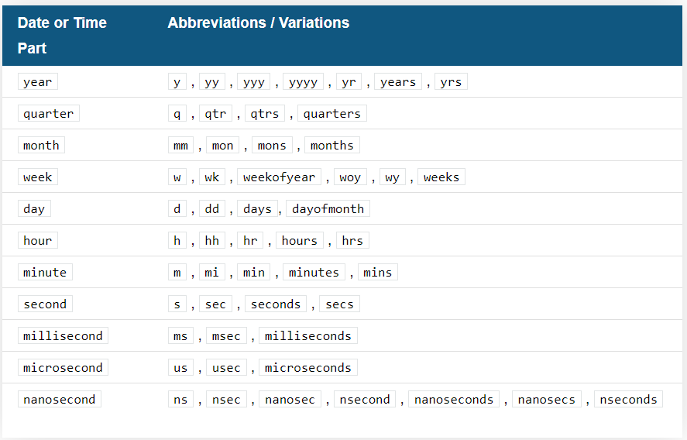
Snowflake – Date & Time
Intervals – Supported Date And Time Formats

Slide 7
Snowflake – Date & Time
Dates – Arithmetic
Snowflake supports the basic addition and subtraction of days to DATE values, in the form of { + | - } <integer>, where <integer> specifies the number of days to add/subtract.
TIME and TIMESTAMP values do not yet support simple arithmetic.
TO_TIMESTAMP / TO_TIMESTAMP_*
Converts an input expression into the corresponding timestamp:
TO_TIMESTAMP_LTZ (timestamp with local time zone)
TO_TIMESTAMP_NTZ (timestamp with no time zone)
TO_TIMESTAMP_TZ (timestamp with time zone)
TO_TIMESTAMP maps to one of the other timestamp functions, based on the TIMESTAMP_TYPE_MAPPING session parameter. The parameter default is TIMESTAMP_NTZ so TO_TIMESTAMP maps to TO_TIMESTAMP_NTZ by default.

